Slide 1
What are Microservices?

Slide 2
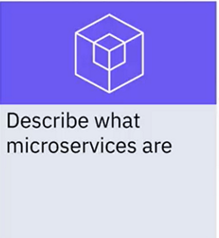
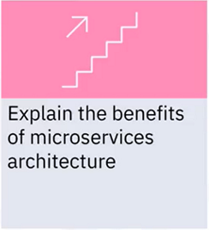
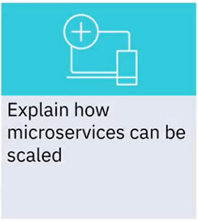
What you will learn

Slide 3
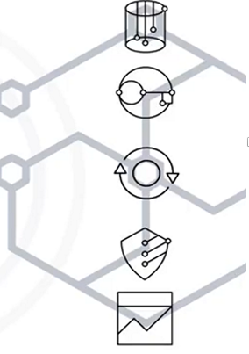
What are microservices?
An approach to create a single application
composed of:
• Many loosely coupted
• Independently deployable
• Smaller services

Slide 4
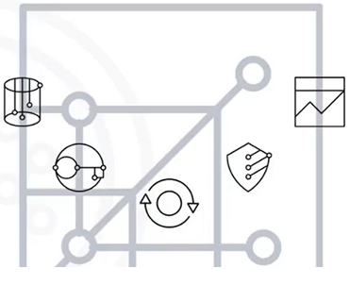
Characteristics of microservices
• Each have their own
technology stack
• Components communicate
with one another
• Functional segregation
(bounded context)

Slide 5
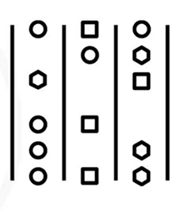
Benefits of microservices
• No interdependency = Easy
updates
• Different stack = Varied
expertise
• Smaller components = Scale
independently

Slide 6
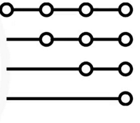
Scaling microservices
• Horizontal scaling
• Precise scaling
• Event driven

Slide 7
Recap
In this video, you learned that:
• Microservices make each application component its own
service, and each service communicates via an API
• Microservices allow application components to use different
technology stacks
• Microservices enable individual components to scale in
response to demand
• Microservices lessen risks associated with change because
components can iterate independently
• Failures in one service do not necessarily impact other services

